Slide 1



Partners in Academia
How can we progress partnership between international development & academia?
Maria DaRocha,
SDG.org.nz Project Manager & Site Editor
Notes:
Hello, everyone.
I’d like to keep my introduction brief - I am Maria DaRocha, the Site Editor and Project Manager of VUWs data-driven SDG initiative, SDG.org.nz
And I am here to talk to you today about partners in academia, using my team’s project as anecdotal evidence.

Slide 2

Collaborative Advantage
We know partnerships between academia, INGOs, and multiple actors often generates new knowledge, innovation, and morphs policies to tackle complex challenges.
Transformational Collaboration
“Smarter” models
Greater Net Value
Notes:
We know partnerships between academia, INGOs, and multiple actors often generates:
new knowledge,
innovation, and
morphs policies
to tackle complex challenges [like the SDGs].
Momentum is gathering for transformational collaboration in addressing the SDGs through “smarter” models to deliver greater impact and net value to all partners.
In this context, we refer to “transformational collaboration” as collaboration which has proven impact and efficacy.
Victoria University of Wellington is at the forefront of this movement, and thus developed the SDG website.

Slide 3
Anecdotal Evidence: SDG.org.nz
2017
2018
2018
2019
Join Sustainable Development Solution Network (AU/Pacific)
Lead Inaugural SDG Summit
Creation of SDG.org.nz data visualisation tool
Partner with Civil Society,
Launch of SDG.org.nz, &
Evolve into a hub for collaboration
A public good contribution by the School of Government, of the Victoria University of Wellington.
Born out of the desire for accountability, education, and cross-sectoral collaboration working to accomplish the SDGs by 2030.
Notes:
Looking at the timeline...
In 2017, we became the first NZ university to sign up to the Sustainable Development Solution Network for the AU/Pacific, an initiative for universities pledging their commitment to the SDGs.
In 2018, our university lead the inaugural SDG Summit in NZ.
Shortly thereafter, we devised this project and built our data tool [which I will cover in a moment].
In July of 2019, we officially launched SDG.org.nz in partnership with civil society organisations, and then evolved into a collaborative hub for the SDGs.
Our website is a public good contribution by the School of Government, of Victoria University of Wellington.
Born out of the desire for accountability, education, and cross-sectoral collaboration working to accomplish the SDGs by 2030 [in accordance with the 2030 Agenda].

Slide 4
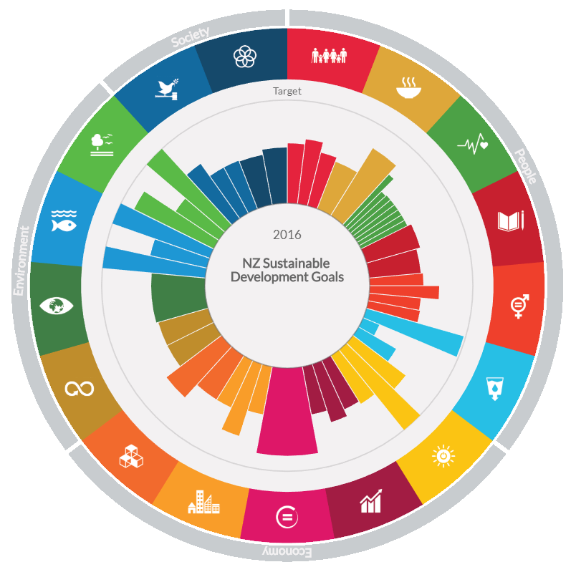
Collaboration
SDG.org.nz
Engagement
Education
Notes:
By way of example, we can investigate the composition of our project.
The project in its entirety is brought to life by a trifecta for successful SDG involvement: Collaboration, Education, and Engagement.
Before we continue, let's take a quick look at the core of the project: The Data Visualisation Tool.

Slide 5
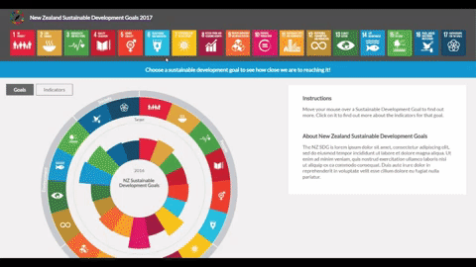
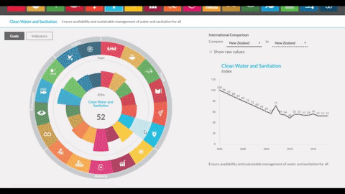
Data Visualisation Tool: OECD data in NZ
Notes:
The tool is an interactive model that tracks NZ's OECD goal progress over time, and its purpose is to hold ourselves (and those in policy making) accountable by tangible measures.
The demonstrations [above] show off the tool's basic functionality.
It allows us to toggle back and forth between a subset of indicators which aggregate to form the benchmark measurement of a goal against its target.

Slide 6
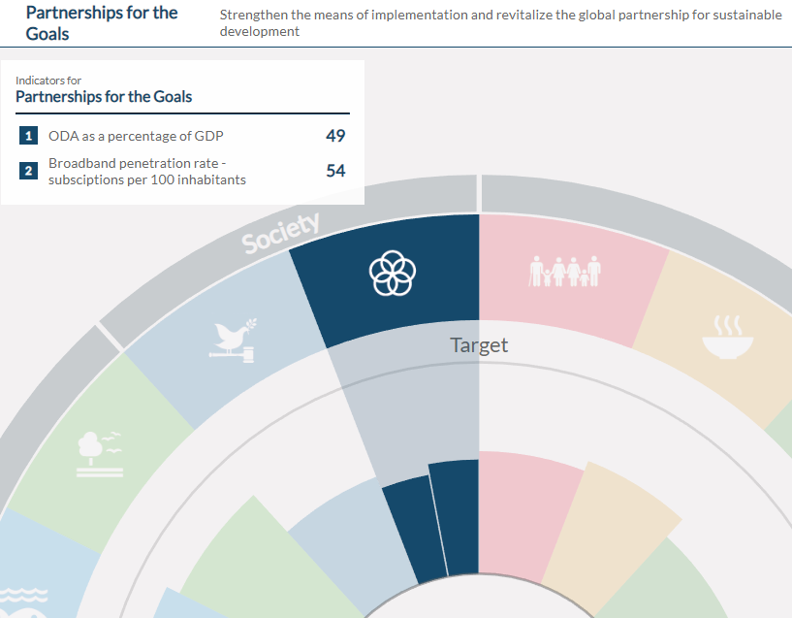
Data Visualisation Tool: OECD data in NZ
https://www.sdg.org.nz/datavis/
Notes:
All goals and our produced indicators can be accessed via our data visualisation page, but partnership indicators may be of particular interest to INGOs.
We hope to expand this set of indicators with the feedback of INGOs who might be willing participants or collaborators.

Slide 7
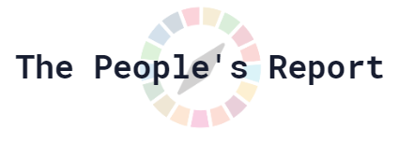
Agile Methodologies
Collaboration
Evidence-Based
SDG Implementation
SDG.org.nz
Engagement
Education
Quantitative Analysis
Influencing Public Policy
Notes:
The layer surrounding our project is quantitative analysis, but does not exclude qualitative analysis.
Our perspective is one through an empirical lense, and we find it crucial to discover means of measuring qualitative indicators, as well.
We approach collaboration and engagement in a way that’s adapted from agile methodologies.
This involves a project approach which focuses on deliverable solutions and involves regular feedback loops.
Between collaboration and education, we rely on evidence-based SDG implementation.
This is rather self-explanatory, but differs from ‘Quantitative Analysis’ in that here we are discussing evidence from direct applications of the SDGs, which may be covered outside the scope of our model.
And the final, but perhaps most important piece is: our aim to influence public policy through engagement and education.
These are the principles behind the website. Through these principles, we can explore its features. To begin, our collaboration with Hui E! introduces further quantitative and qualitative investigation of our progress towards the SDGs.

Slide 8

The People’s Report
Alternate report on the SDGs from a civil society perspective
17 reports
20 contributors
Individual or organisational perspectives on a particular goal or target
https://www.sdg.org.nz/peoples-report/
Notes:
The People's Report is a large-scale undertaking by 20 different contributors, comprised of 17 different reports reflecting individual or organisational perspectives on a particular goal or target from a Civil Society perspective.
It's a phenomenal body of work. I'm proud that we are able to host it on our website, and am looking forward to expanding that space with Hui E! in the very near future.

Slide 9

Agile Methodologies
Collaboration
Evidence-Based
SDG Implementation
SDG.org.nz
Engagement
Education
Quantitative Analysis
Influencing Public Policy
Notes:
If we revisit our model…
'Upcoming events’is a website feature enabling external collaboration, and as the name implies, education about upcoming events in Wellington and Auckland.

Slide 10
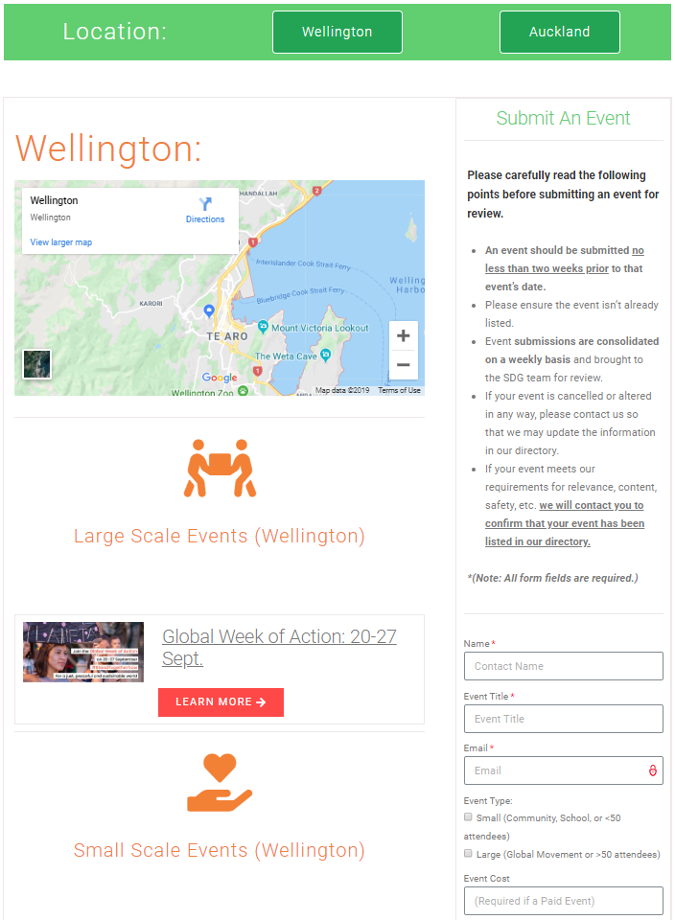
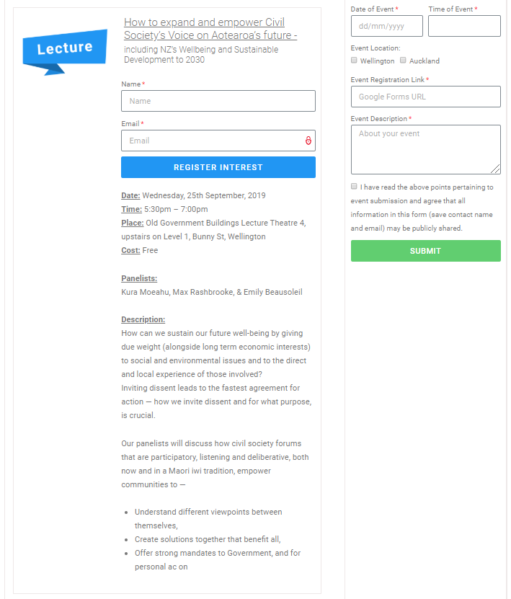
Upcoming Events
Notes:
We allow event submissions, which [for capacity reasons] are consolidated and reviewed on a weekly basis.

Slide 11

Agile Methodologies
Collaboration
Evidence-Based
SDG Implementation
SDG.org.nz
Engagement
Education
Quantitative Analysis
Influencing Public Policy
Notes:
Next we have webinars...

Slide 12
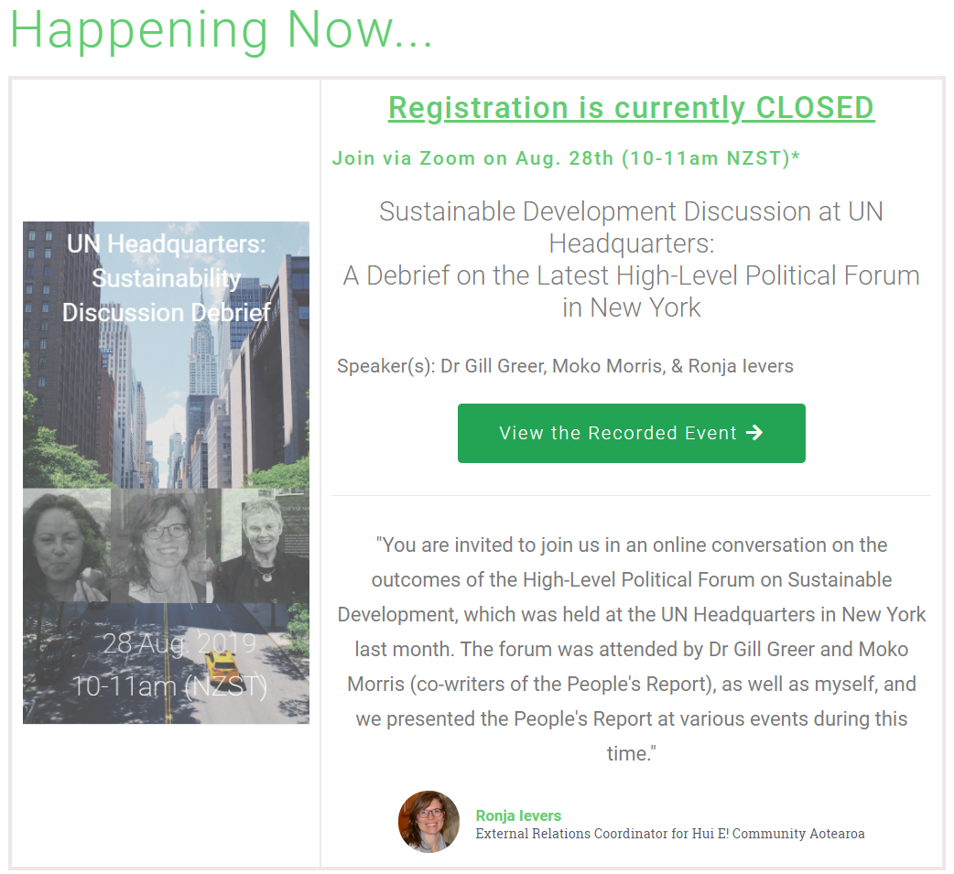

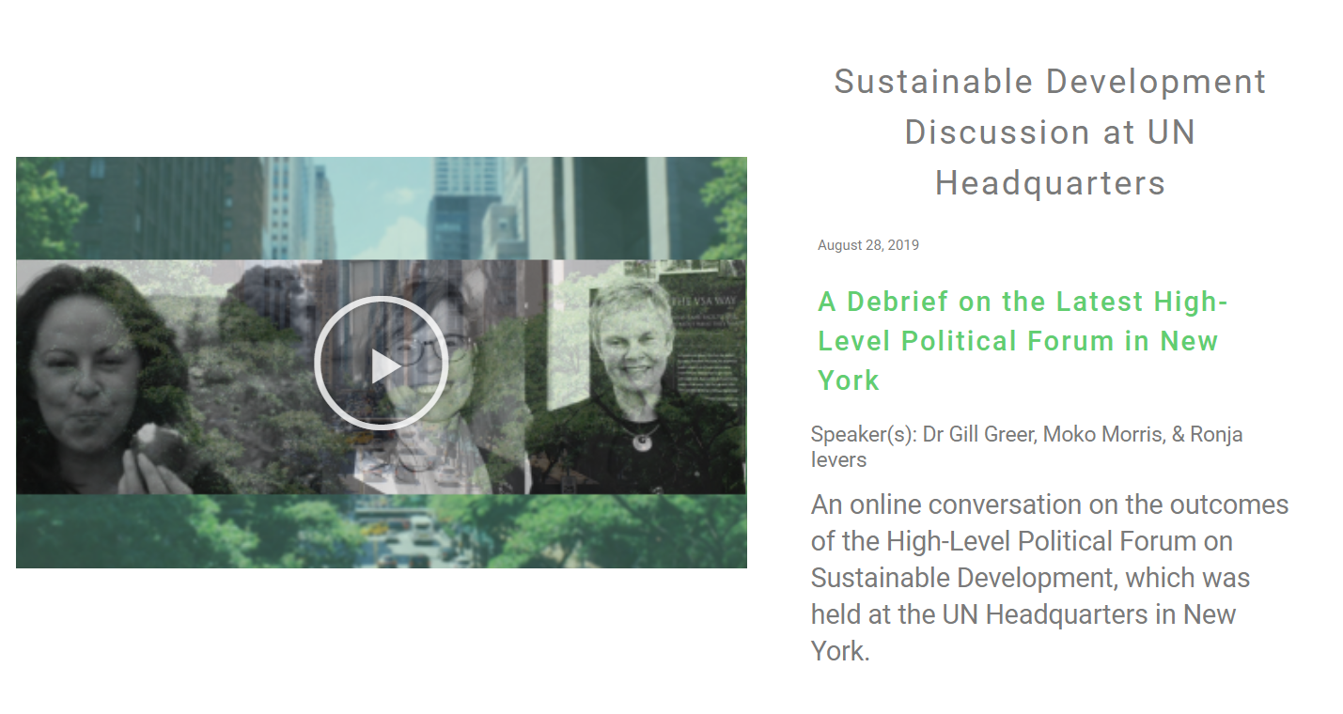
Webinars
Notes:
Webinars are opportunities for resident experts, specialists, or those who are just generally knowledgeable on the SDGs to make ideas or information accessible to a target audience of “New Zealand at large.”
With webinars, the public has an opportunity to engage directly with the material and the speaker at the end of a session.
We make these free to register for and participate in.
The next webinar is in early November and we’ll discuss ‘Climate Change Implications for NGOs’ with Injy Johnstone, so you can keep an eye out for registration opening by the end of this week if you're interested in that event.
But, the main point here is that webinars are another example of openings for INGO engagement with us - through the delivery of information to others in an engaging way.

Slide 13

Agile Methodologies
Collaboration
Evidence-Based
SDG Implementation
SDG.org.nz
Engagement
Education
Quantitative Analysis
Influencing Public Policy
Notes:
Next we have blogs...

Slide 14
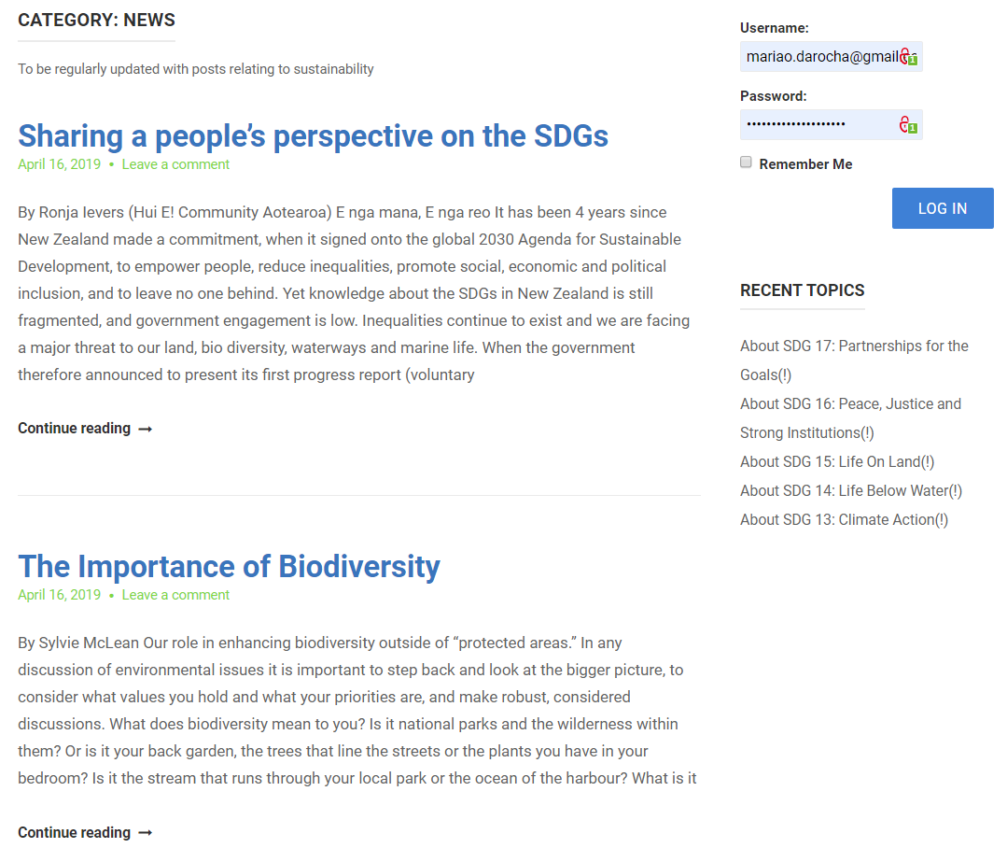
Blogs
Notes:
Yet another example of openings for INGO engagement with us. Guidelines for blog topics are loose, but must be factual and from a reputable source.
This follows the same premise as webinars, but uses a different medium to communicate information.
We are actively seeking both:
Prospective webinar presenters, and
One-off or repeat contributors to our educational blog series

Slide 15

Agile Methodologies
Collaboration
Evidence-Based
SDG Implementation
SDG.org.nz
Engagement
Education
Quantitative Analysis
Influencing Public Policy
Notes:
And finally, Discussion Forums...

Slide 16
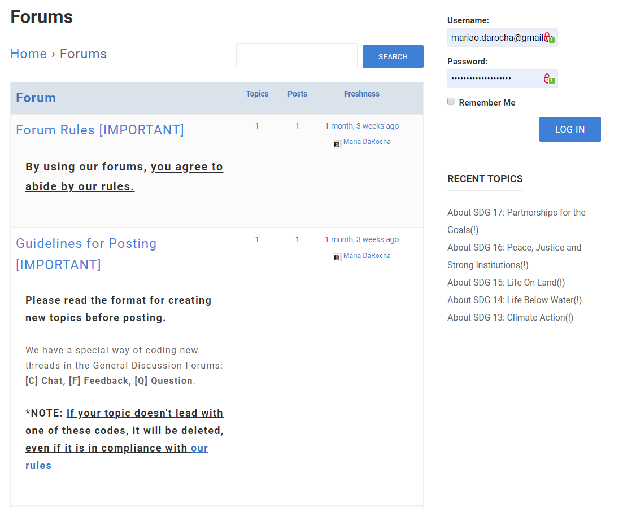
Forums
Notes:
Quite straightforward… a means of connecting others and providing a space for constructive conversation.

Slide 17
Agile Methodologies
Collaboration
Evidence-Based
SDG Implementation
SDG.org.nz
Engagement
Education
Quantitative Analysis
Influencing Public Policy
Notes:
And so, this visualisation summarises our project…
There are other initiatives we are acting on at the moment, such as developing lesson plans for schools on the SDGs and so on, but for time's sake, I can't elaborate on those just here.

Slide 18
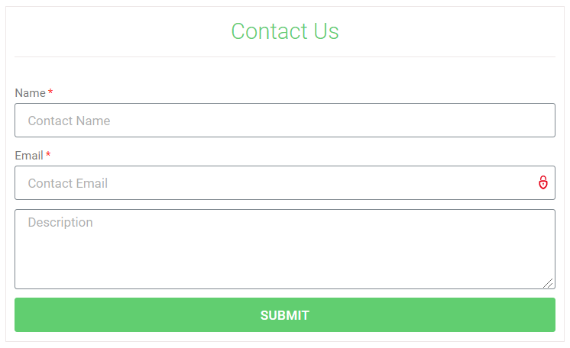
Thank you.
Victoria University of Wellington would like to invite you to join us in this collaboration journey.
https://www.sdg.org.nz/contact-us/
Notes:
Thank you for your attention, and on behalf of VUW we formally invite you and the organizations you represent to collaborate with us.
Feel free to seek me out here today, or for simplicity you can use the 'Contact Us' form available on our website at:
SDG.org.nz/contact-us/
Thank you, again.

