Slide 1

Setting the scene: An evidence driven strategic prioritization of investment opportunities to address the SDGs New York, May, 2018
A transformative Agenda
for
Women, Youth and Adolescents Across the Pacific

Slide 2
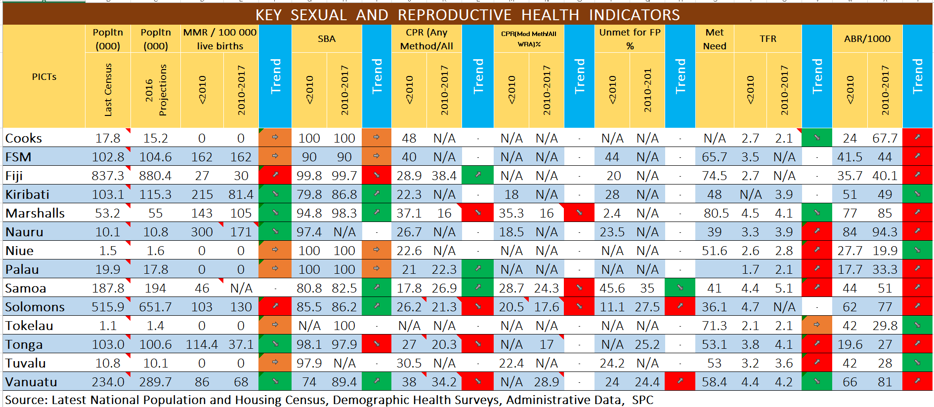
RMI
FSM
Cooks
Tuvalu
Alarming negative trends can be observed
6 of 14 TFRs are increasing
10 of 14 Adolescent Birth Rates are increasing

Slide 3
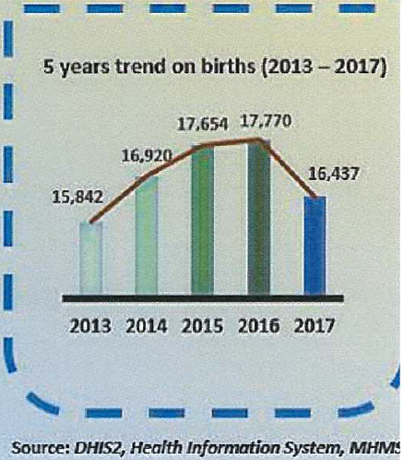

Data just released by the Ministry of Health in Solomon Islands during May 2018 planning meeting

Slide 4
Data just released by the Ministry of Health in Solomon Islands during May 2018 planning meeting

Slide 5
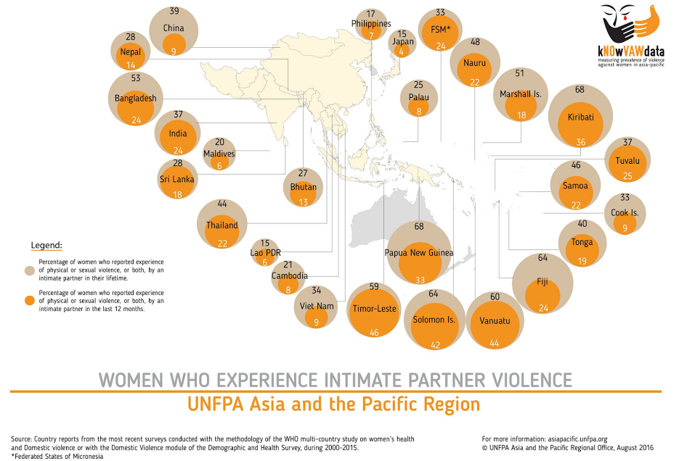
UN Women Slide
Positive:
Current Violence Lower suggests women have more options
Pacific
Lifetime Violence
>50%
Negative:
Current & Lifetime Violence Close: no way out
Notes:
The main issue of this slide is that is shows that in the Pacific life time violence is rather close to current violence (which is rather unusual..), and this is due to very limited/no options to end the violent relationship with the partner as legislation is weak/ poorly implemented; divorce and separation is not really available/ or no option for the women (and not accepted in society; women are not financially independent; prevention and response services have limited influence/are not readily available and violence is accepted by both women and men as part of life/part of marriage

Slide 6
If, together, we build her a bright future, we will transform the future of humanity and no one will be left behind… Vinaka Vaka Levu

