Slide 1


Social enterprise in not-for-profits
Making money while keeping your mission safe

Slide 2
Challenges
How social enterprises can work in a not-for-profit
Why social enterprise is a good idea for not-for-profits

Slide 3

New source of good
Social entrepreneurship – opportunistic innovation
Social innovation – better systems products & services to meet need
Social impact – identifying the difference we make
www.fitzgerald.org.nz and www.socialenterpriseauckland.org.nz

Slide 4
Organisational types
Type of enterprise
Focus
Income sources
Not-for-profit business
Mission
Social impact
Grants and donations
Earned income, fees, contracts and donations
Social enterprise
Mission and market
Profit reinvested in social impact
Break-even through commercial revenue
Profits are reinvested in social impact
Social business
Market & mission
Social impact and profit distributed
Socially driven and profit making
For-profit business
Market
Profit
Socially responsible business
Business donating to charity
Social value creation focus Commercial value creation focus

Slide 5


Different organisational species
Not-for-profit
Social enterprises

Slide 6
Differences in Logics
Characteristic
Desired outcome
Primary driver
Tactic
Source of legitimacy
Funding source
Stakeholders
Performance measures
Social (not-for-profit)
Social value
Values-based mission
Collaborative
Unity of purpose
Contracts and donations
Clients and families, funders, community
Quantitative social output, financial measures, and qualitative social impact stories.
Commercial (for-profit)
Economic value (profit)
Market preferences
Competitive
Market position
Trading income
Customers, owners
Quantitative financial measures (e.g., profit, ROI)

Slide 7
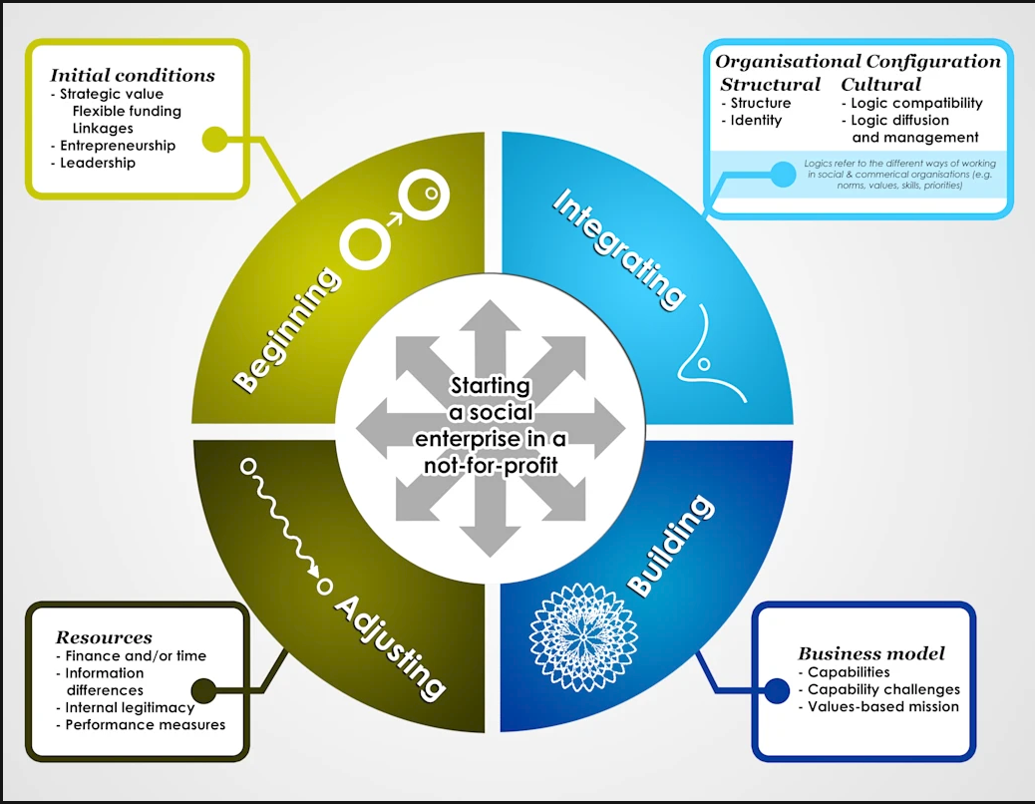
Issues to consider

Slide 8
Business model
Key Partners
Key Activities
Customer Relationships
Value Propositions
Customer Segments
Key Resources
Channels
Cost Structure
Revenue Streams

Slide 9
Issues to consider
www.socialenterpriseauckland.org.nz www.fitzgerald.org.nz

Slide 10
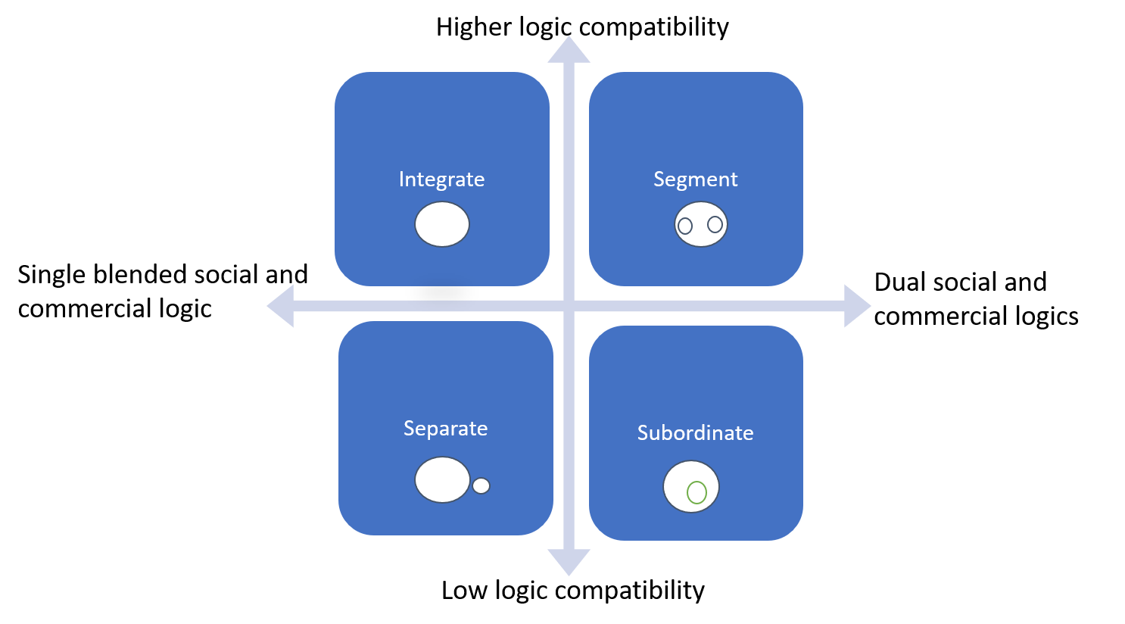
Structure

Slide 11
thank you

