Slide 1
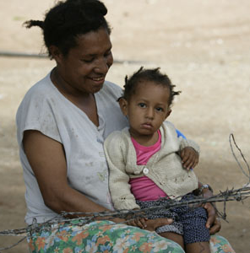

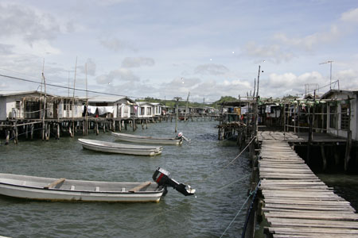
Competence, capability and capacity – where does TA fit in?
Graham Teskey
Wellington
Ministry of Foreign Affairs and Trade
August 8th, 2019

Slide 2
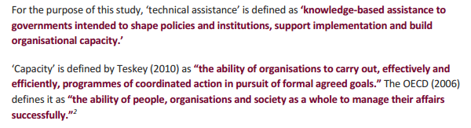
TA (input) and CD (objective)

Slide 3
Contents - 17 slides
Preface: sending some letters
Part 1: Technical assistance: does it work?
Part 2: Capacity development
Evolution of ideas
Watch your language
Institutions and organisations
Five core features
The idea of ‘specificity’
How long must we wait?
Some conclusions

Slide 4
Sending letters (i)
159 countries have signed up the UPU convention: internal misaddressed letters to be returned in 30 days.
So – a recent experiment. 10 misaddressed letters sent to all 159 countries
What happened?

Slide 5
Sending letters (ii)
If measured within 90 days - results went from full compliance (i.e. all 10 came back) to zero
High compliance: Norway, El Salvador, Czech Republic, Finland…Uruguay
Zero compliance: Somalia, Myanmar and Fiji

Slide 6
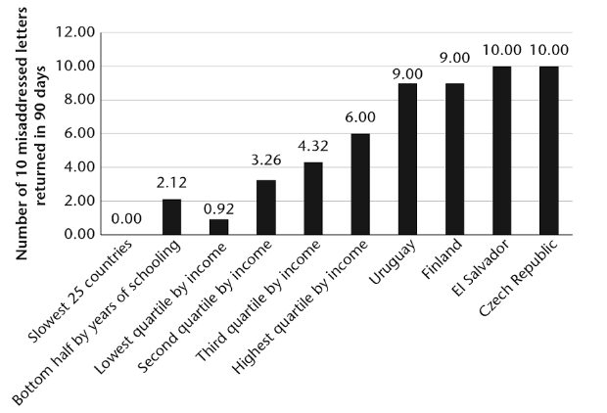
Sending letters (iii)

Slide 7
TA: A huge industry
2016 US $18.4 billion (OECD) – this excludes TA associated with specific projects
Others estimate it at US $40 bn or approx. 25% total global aid

Slide 8
So – does TA work? (i)
It can be a silly question…
All depends on the objective:
  transfer learning to one counterpart?
  transfer systems and processes to a department?
  transform the functioning of the agency?
  Keeping something going?

Slide 9
Does TA work? (ii)
Often no base-line so how do we know?
Poor M and E
Little interest in in-depth investigation (everyone thinks they know about CD)
Supply driven – used as insurance for donor funds (is this success?)

Slide 10
Does TA work? (iii)
All depends on the objective:
  For specific tasks, 1-2-1 learning, adoption of low-discretionary systems it can work (why are Central Banks in poorer countries always well performing?)
  For organisation-wide change – results very mixed but in the main are poor in weak institutional environments (yes if high profile, high status, with RAR effectively delegated)
  Wholly unlikely to deliver transformational change unless the wider institutional environment is supportive – all those incentives and drivers

Slide 11
TA / CD Evolution of ideas
Period | Focus | Mode of Intervention | Dominant Ideas | Capacity Development Paradigm
1970s | The Individual | Skills acquisition Tools and equipment | Counterparts Gap-filling | Scholarships; Developed country training, Manpower (sic) reviews, Line positions, On-the-job training
1980s - mid 1990s | The Organisation | Reconfiguring organisational structures (“moving the chairs around”…) Reforming and/or Strengthening: systems for policy making, managing people, information, cash and assets | Business Management Business Process Re-engineering | Organisational audits, restructuring Job evaluation and grading Job descriptions Advisers
Late 1990s onwards | The Institutional Environment | Incentive structures within formal organisations: human resources management (pay, discipline, performance management) The wider institutional environment: Accountabilities | New Institutional Economics (“The Rules of the Game”): exit voice loyalty and compliance | Sector or “whole” budget support (setting the incentive framework) Public expenditure management Performance management Pooled TA

Slide 12
Capacity – watch your language
it is organisations that have capacity. Individuals have skills and competencies
organisations also have particular and specific capabilities to do things such as manage people, carry out customer research, account for the use of monies etc. Capabilities are thus the building blocks of any organisations overall capacity to perform
organisations operate in a wider institutional environment that either may support or circumvent the organisation’s ability to carry out its formal collective goals

Slide 13
CD – different forms
Capacity development
Capacity supplementation
Capacity substitution

Slide 14
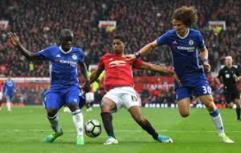
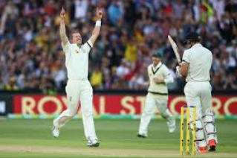
Organisations and institutions
Organisations have walls and chairs and tables and staff and objectives. Institutions are the rules of the game – formal and informal

Slide 15
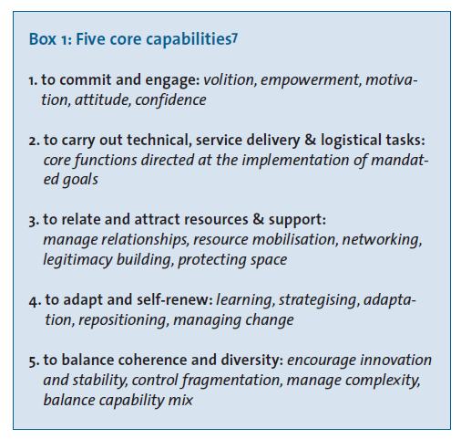
Five core capabilities that constitute ‘organisational capacity’

Slide 16
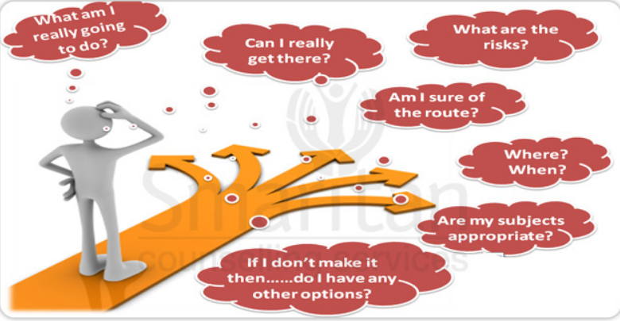
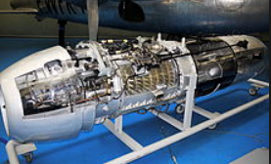
Specificity
Discretion and ‘monitorability’ and immediacy of impact…..

Slide 17
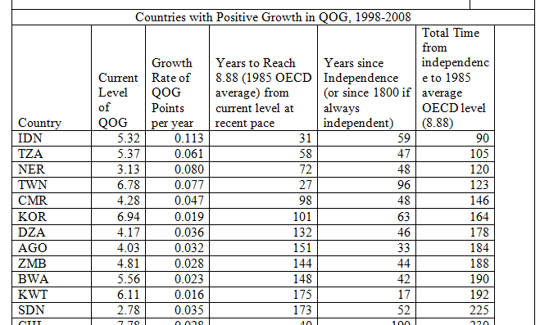
How long does it take?

Slide 18
So what is it that makes an organisation function effectively?
Individually:
Skilled
Trained to do the job
Clear JD and annual work plan
Equipped (kit, tools etc.)
Organisationally:
Well structured: form follows function
Spans of control
Jobs evaluated / graded and consistent
Clear vision
System enabled (IT, HR, information)
Institutionally:
Supportive environment
Powerful and visionary leadership
Incentivised (pay, commitment, drive)
Valued and rewarded for a good job
Consequences of a poor job
Sense of fair play

Slide 19
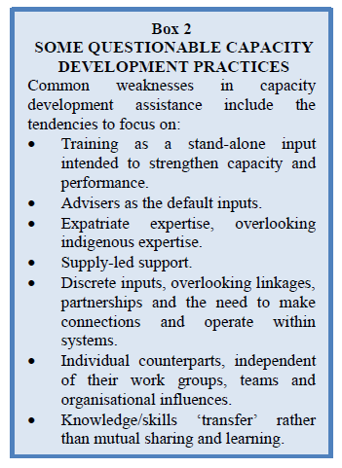
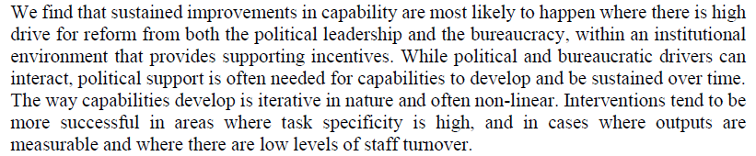
Conclusion…..
“Turning individual competence into organisational capacity requires institutional change”

