Slide 1
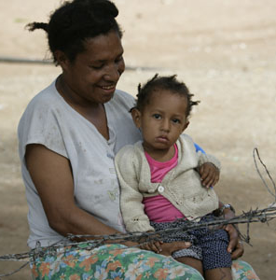

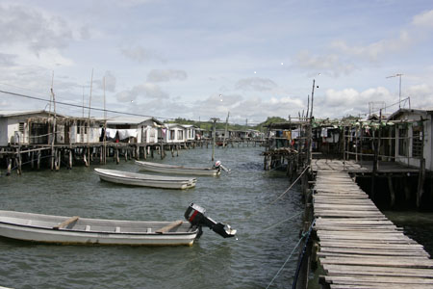
Improving governance and service delivery in PNG
Graham Teskey
Ministry of Foreign Affairs and Trade
Wellington
August 7^{th,} 2019

Slide 2
Two parts
    What can we say about governance in PNG? 10 slides
    What can we say about public service reform and service delivery? 8 slides

Slide 3
(i) What can we say about governance?
    For any assessment there has to be:
    A ‘framing’ of governance
    Agreement on country comparators
    What data to interrogate

Slide 4
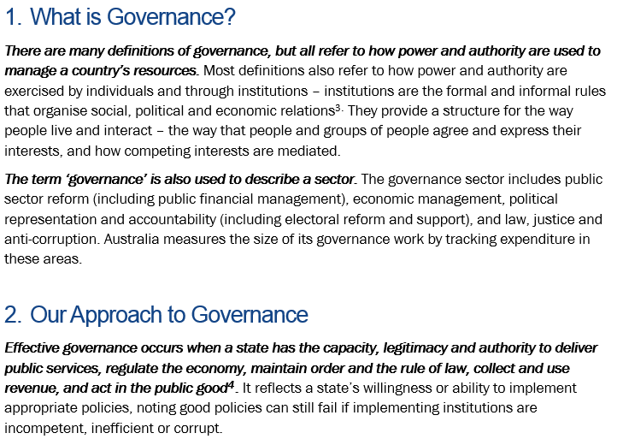
PNG – Australia
Governance
Partnership
Governance: DFAT

Slide 5
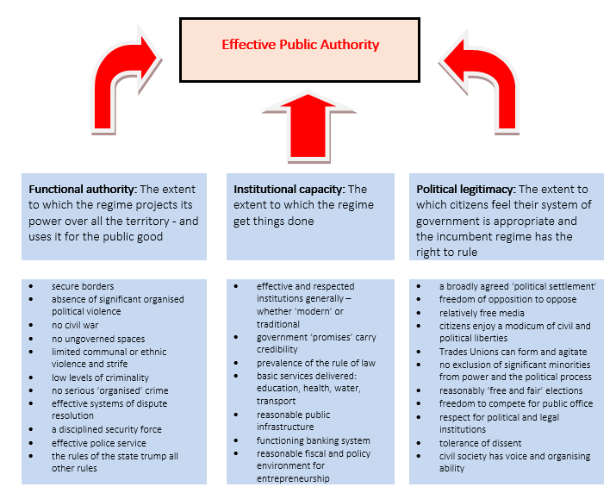
PNG – Australia
Governance
Partnership
Capturing governance

Slide 6
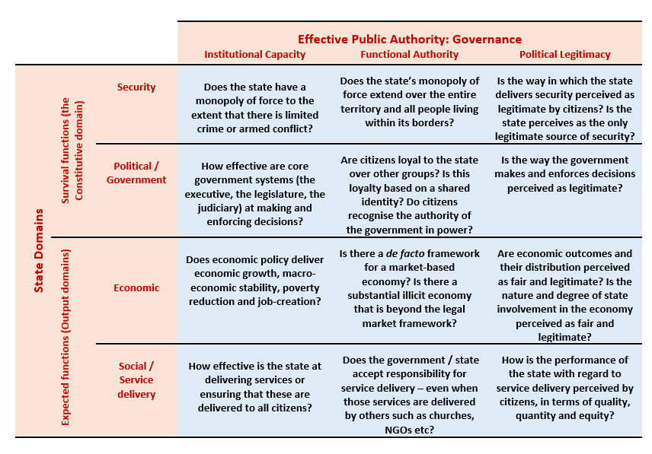
PNG – Australia
Governance
Partnership
Survival and Expected functions

Slide 7
PNG – Australia
Governance
Partnership
The methodology
  13 developing countries were selected as comparators: four in the region (Fiji, Solomon Islands, Vanuatu and Samoa) and nine others (Angola, Cambodia, Ghana, Lao PDR, Mongolia, Myanmar, Sri Lanka, Timor Leste and Zambia)
  76 indicators were selected from 15 different publically-available datasets. Overall an 82.4% coverage rate was achieved, with Vanuatu having the lowest rate at 46.1% and Angola, Cambodia, Ghana and Sri Lanka having the highest at 100%.
  While the Governance Update reflects on the state of governance in the previous calendar year (with the 2017 report covering assessment for January-December 2016), actual datasets ranged from May 2015 to December 2016
  As this 2017 assessment is the first of its kind for PNG and the PGF, data for each sample country was also collected for two time periods prior to 2017: 2013 and 2010 respectively

Slide 8
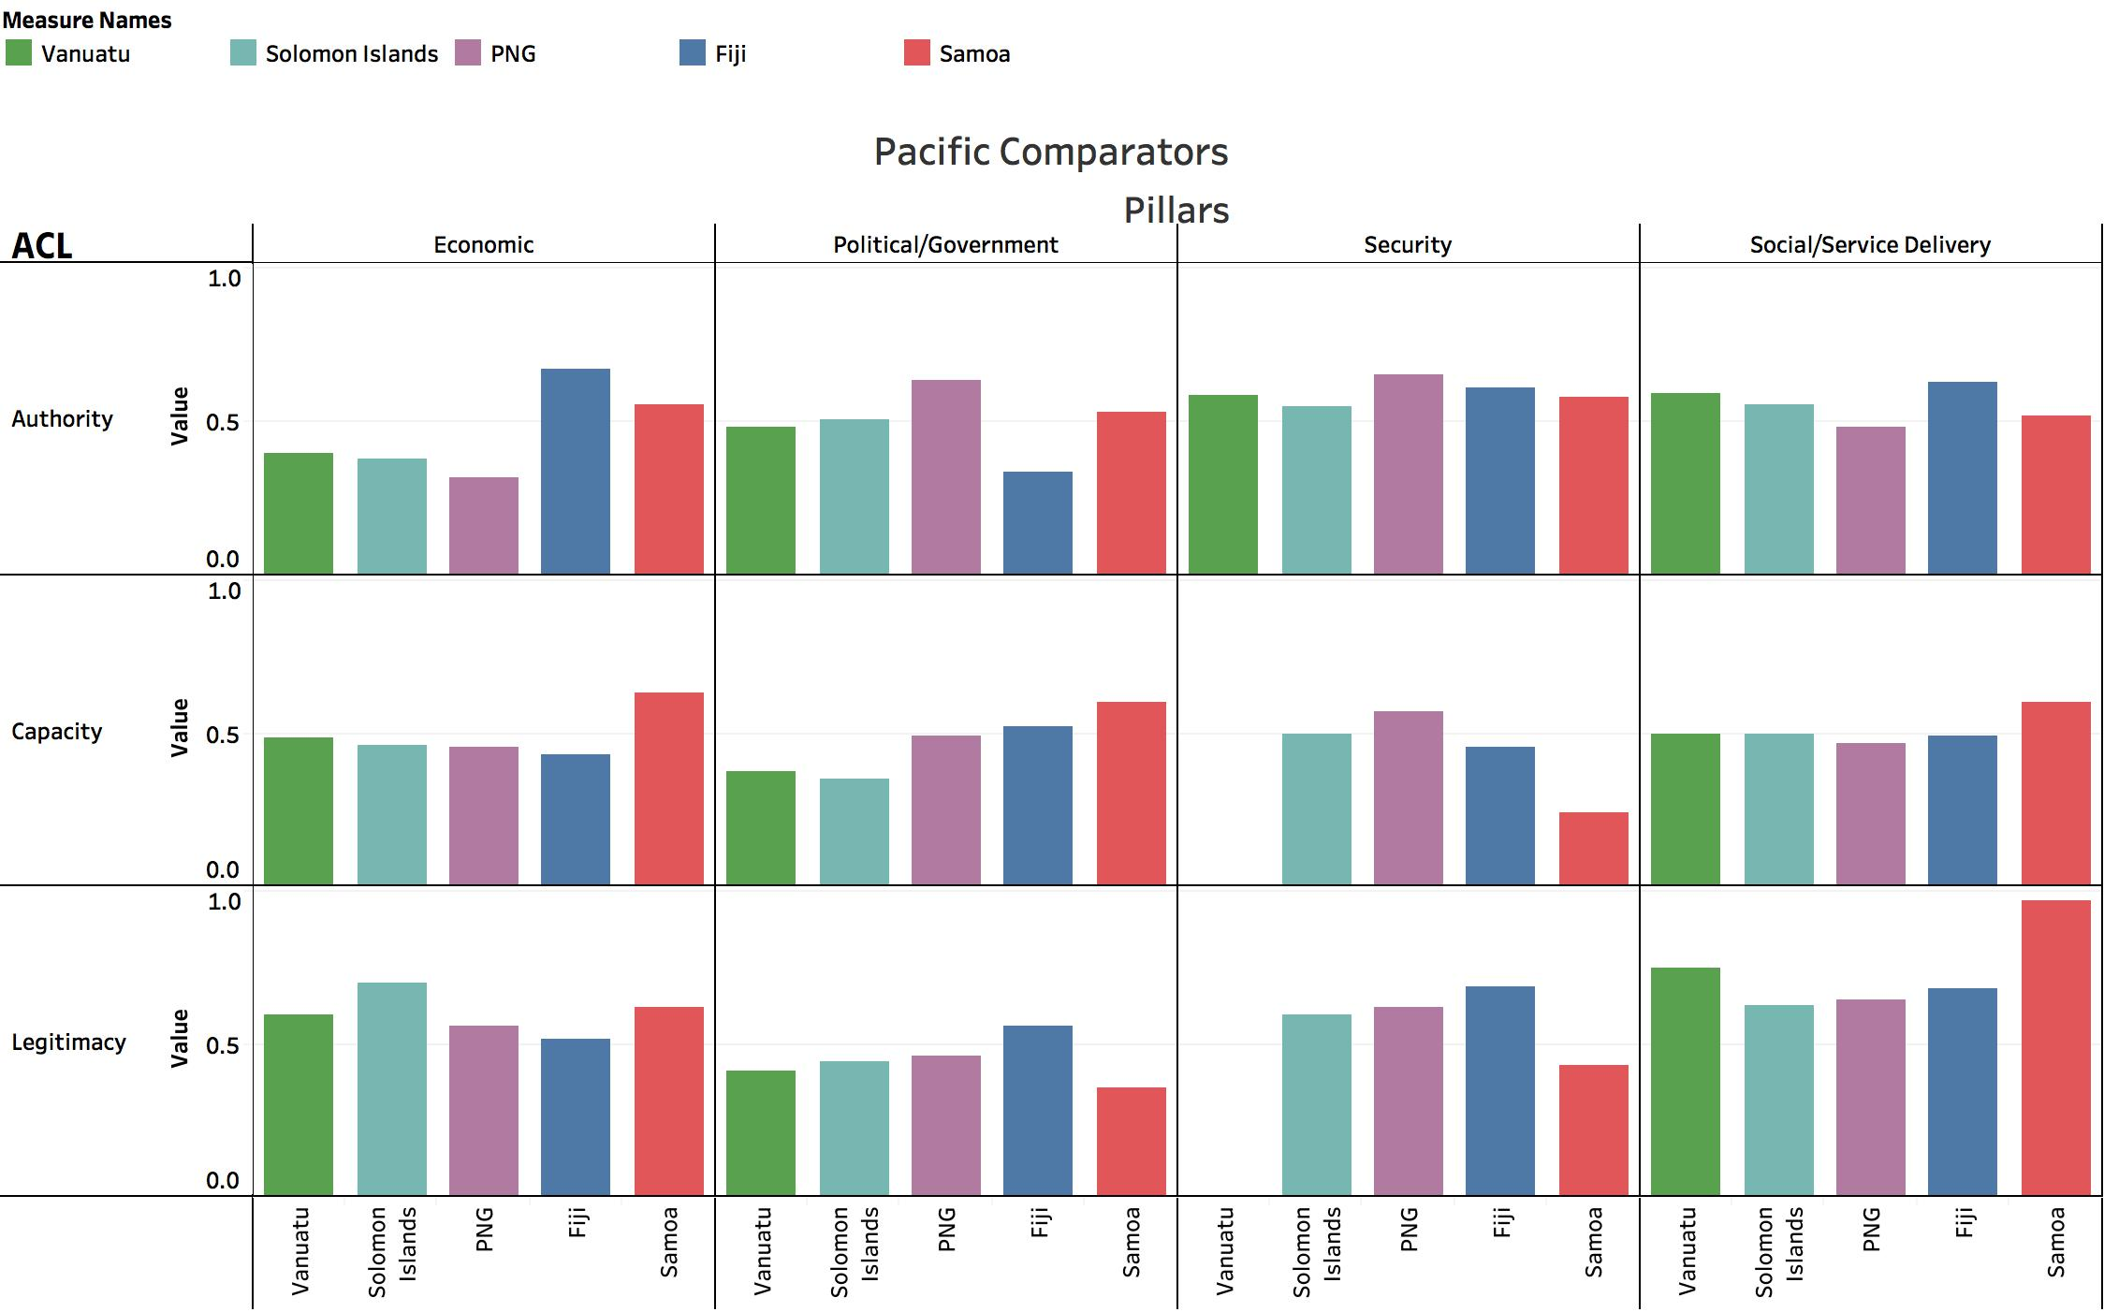
PNG – Australia
Governance
Partnership
Findings (ii) PNG and the Pacific

Slide 9
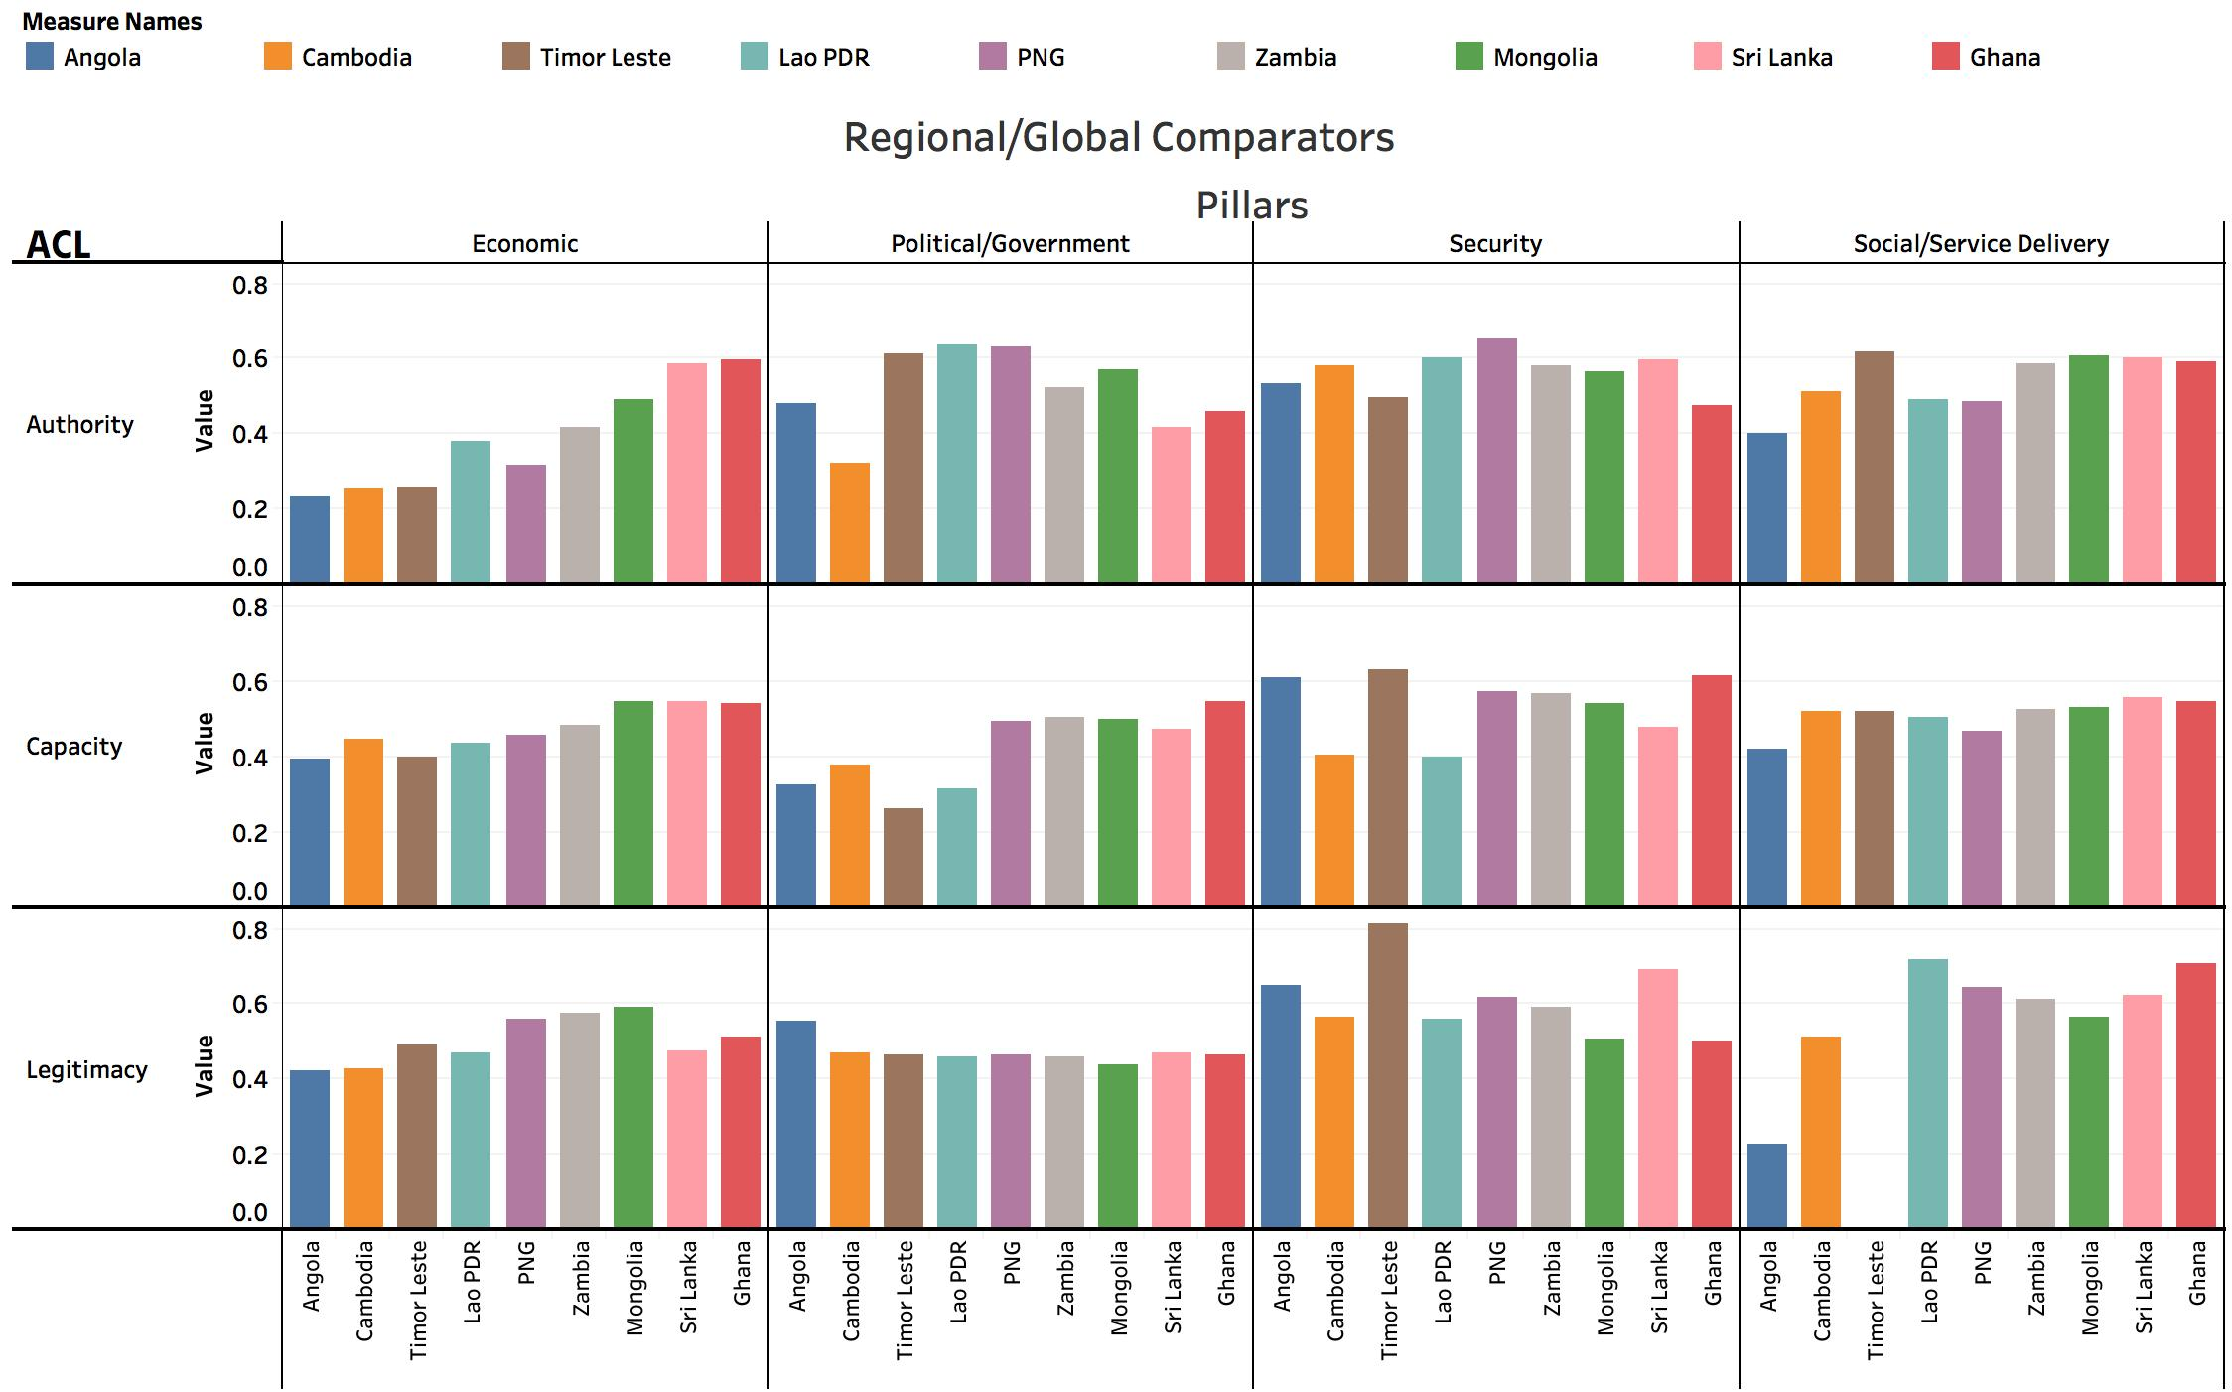
PNG – Australia
Governance
Partnership
Findings (iii): PNG and the nine

Slide 10
PNG – Australia
Governance
Partnership
Summary
That the state of governance in PNG has improved in absolute terms in most domains of A, C and L since 2010, with exception of the provision of security, where both state legitimacy and authority have declined
The overall state of governance in PNG is on par with that of other Pacific nations
Governance in PNG about as ‘effective’ as its level of development would suggest; no better or no worse

Slide 11
PNG – Australia
Governance
Partnership
Some high level conclusions
PNG’s governance challenge revolves less around capacity and more around authority and accountability
Partners cannot expect PNG to ‘skip straight to Weber’ and put in place – in short order - a functioning, effective and transparent bureaucracy
PNG is not a failed state, nor is it heading in the direction
Although PNG does possess some unique characteristics (as do all countries) it is by no means unique in its development trajectory

Slide 12
What can we say about service delivery? #1

Slide 13
Conceptualising PSR…
The mystery of public service delivery
Upstream: PSR programs to improve core government management functions
Service delivery outputs / outcomes much easier to measure
But do we understand the mix of incentives and accountabilities that operate here?
What is the transmission mechanism?
How can we be sure of attribution?
Downstream: programs designed to improve service delivery improvements
PSR intervention
Central (upstream) public system management improvements
Delivery improvements
Policy improvements
Which bits of upstream policy settings / systems are critical?
Do we know enough about the accountabilities that may incentivise such change?
Can we measure such upstream change?
Cross-cutting process improvements

Slide 14
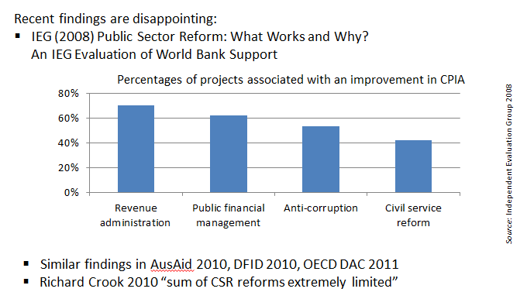
Are cross-cutting, upstream reforms doomed to fail?

Slide 15
No………….
Investing in upstream reforms in countries with strongly limited civil liberties and political rights is distinctly more risky than investing in other sectors in these countries. This is consistent with theory that would suggest that undertaking performance reforms to the machinery of government is difficult where political incentives for reforms are weak due to limited citizen accountability and strong opposition from vested interests.

Slide 16
What can we say about service delivery? #2
Searching for small solutions in improving health and education service performance in Solomon Islands and PNG
Terence Wood ANU
Proposal: to develop an analytical method to allow us to learn about feasible small-scale reforms from within-country variation in the quality of service delivery

Slide 17
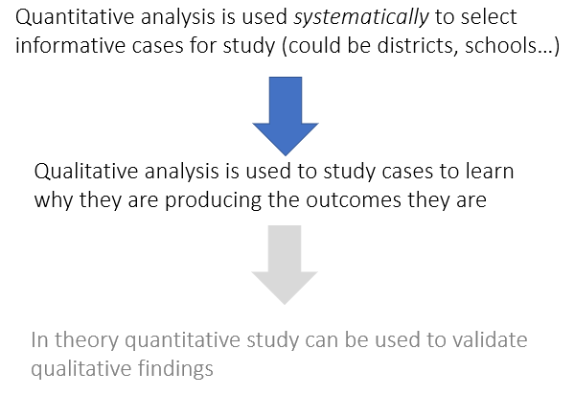
Alternative approaches

Slide 18
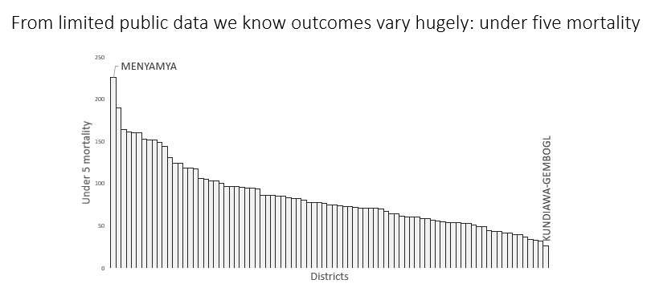
Alternative approaches
Some variation is a result of features we have no control over: i.e. Child mortality is lower in places too high to have Malaria. And it is higher in poorly accessible parts of the country
This knowledge is “boring” in that it doesn’t offer us much insight into how we can improve practices in delivery.
However…

Slide 19
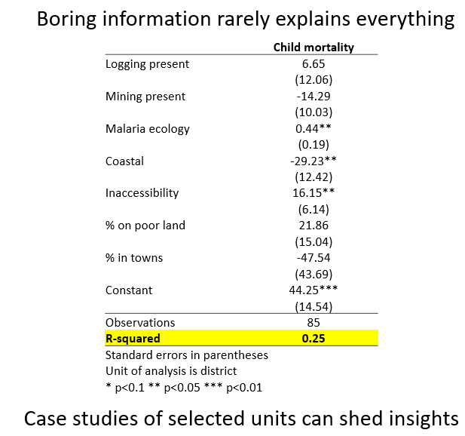
Alternative approaches

Slide 20
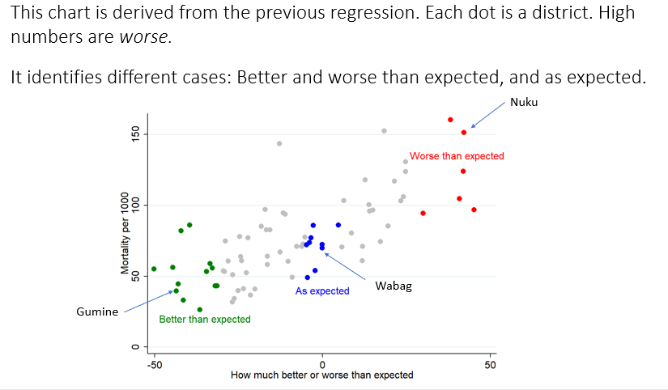
Alternative approaches

