Slide 1
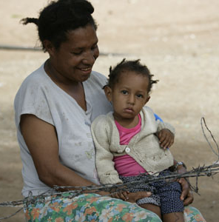

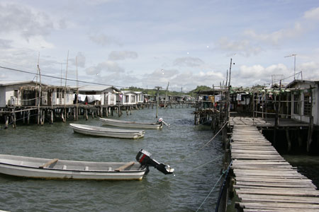
Thinking and working politically
Graham Teskey
Ministry of Foreign Affairs and Trade
Wellington
August 7^{th,} 2019

Slide 2
Two starting points for 12 slides
This is work in progress: there is as yet no definitive or unequivocal way of how to do TWP
Want to test the framework against your experience

Slide 3
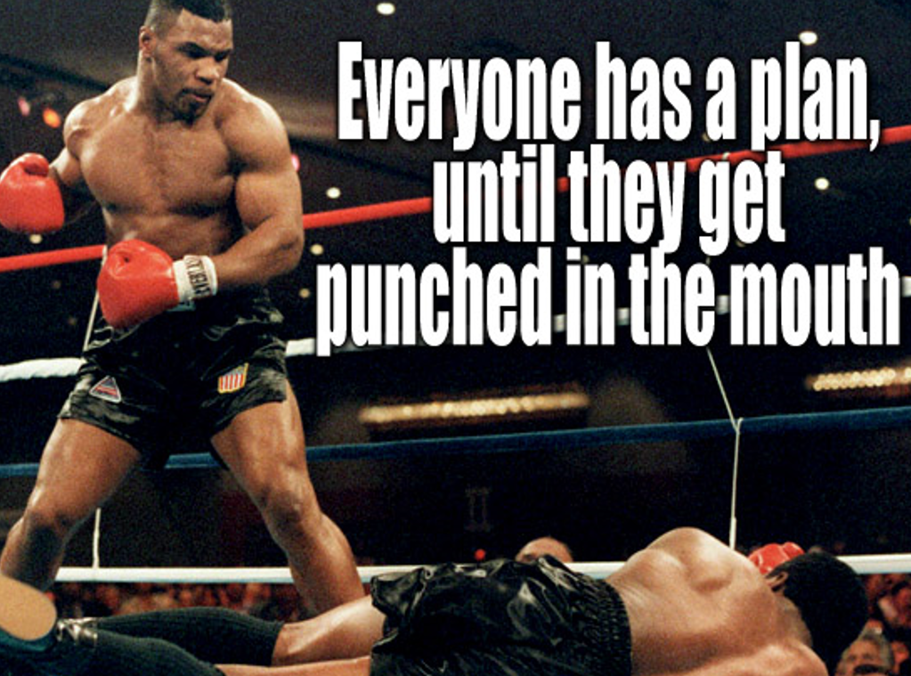
The case for TWP in one picture

Slide 4
The case for these ‘new’ approaches in words
Developmental change is fundamentally political
Growing body of evidence that failures of ODA largely due to poor understanding of politics, and inability to adapt to politics and local interests
Traditional aid attempts to be apolitical, focusing on technical knowledge transfer, capacity strengthening, and funding gaps
When real change happens, it usually involved:
      Contestation between factions, producing winners and losers
      Informal coalitions of groups with shared interests combining forces
      Resistance by entrenched actors, benefitting from the status quo
      Elites or powerful actors, pursuing their own interests, supporting the change
Despite evidence, mainstream ODA only now beginning to change

Slide 5
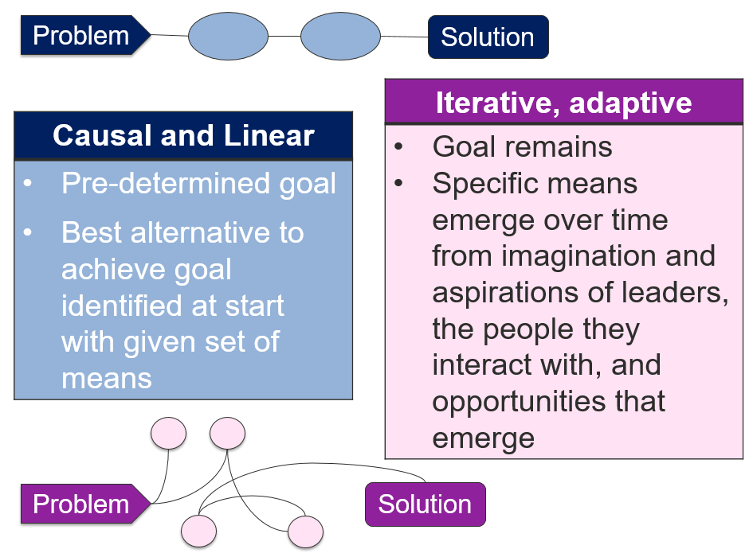
From linear to adaptive

Slide 6
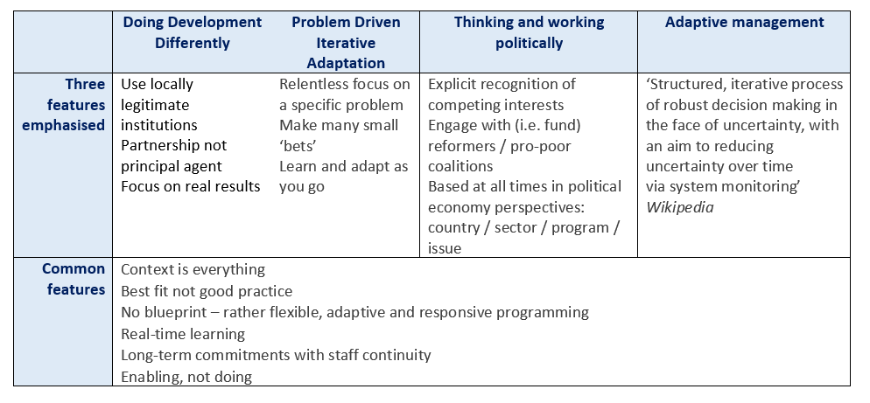
DDD, TWP. PDIA and AM

Slide 7
The TWP bit of the Log Frame
Narrative Summary | OVI | Source | Assumptions (‘if…then”)
Impact
Outcome
Outputs
Activities
Explicitly taking these assumptions on board is what makes TWP different

Slide 8
Three stages in the program cycle where TWP matters
Selection
Design
Implementation

Slide 9
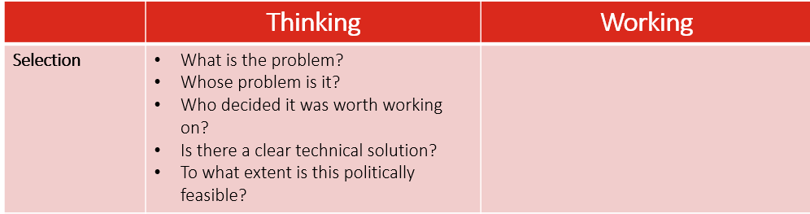
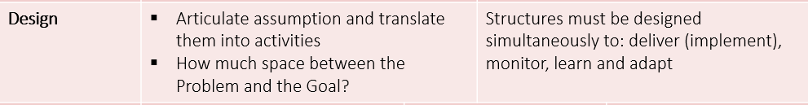
Implementation: delivering activities (how are we doing on physical progress?)
Monitoring: the regular and frequent checking of progress towards achieving outputs (are we on track against the plan, the budget – and most importantly – against outputs and possibly outcomes?)
Learning: our reflexive questioning of progress - what are we learning about translating inputs and activities into outputs and outcomes (what is working and what isn’t?)
Adapting: revising our implementation plan, adding unforeseen activities and dropping others, changing the balance of inputs, be they cash, people or events etc. (how are we changing the plan?).

Slide 10
 | Thinking |  | Working
Selection | What is the problem? Whose problem is it? Who decided it was worth working on? Is there a clear technical solution? To what extent is this politically feasible?
Design | Articulate assumption and translate them into activities How much space between the Problem and the Goal? |  | Structures must be designed simultaneously to: deliver (implement), monitor, learn and adapt
Implementation | Flexibility Increase spending and budget in year Decrease spending or budget in year Increase pace of implementation Decrease pace of implementation | Adaptation Change articulation of Outputs Add new Activities Drop Activities Revise milestones Revise the ToC |  | Responsiveness To policy changes of funder To policy changes of host government To sudden and major political, economic or social events (Nepal going federal is a good example)

Slide 11
 | Flexible? | Adaptive? | Responsive?
KOMPAK Indonesia, DFAT | Budgets increased and decreased – at both DFAT and program request Some evidence of speed up / slow down (pragmatic) | Little evidence regarding in-year design changes New Activities added in next AWPB; not in-year | Strong - to GoI and DFAT priority needs Some evidence of responding to changing local circumstances and context
PNG Governance Partnership, DFAT | Little flexibility in first two years Some program budget virements at year’s end to meet DFAT spending needs | Little evidence to date of in-year adaptation to local policy circumstances No new in year Activities | Overwhelmingly to DFAT priorities, esp. Minister Yes to major GoPNG policy shifts
Timor PHD DFAT | Limited due to volume of funds committed to legacy programs | Evidence of some change in new AWPBs | To DFAT strong; some emerging evidence of responsiveness to GoTL
Health Sector Support, Nepal, DFID | Yes at specified points e.g. MTR | Some evidence that contractors responding in year on agreed Activities | Yes to DFID and GoN – and especially to federalism (no choice!)

Slide 12
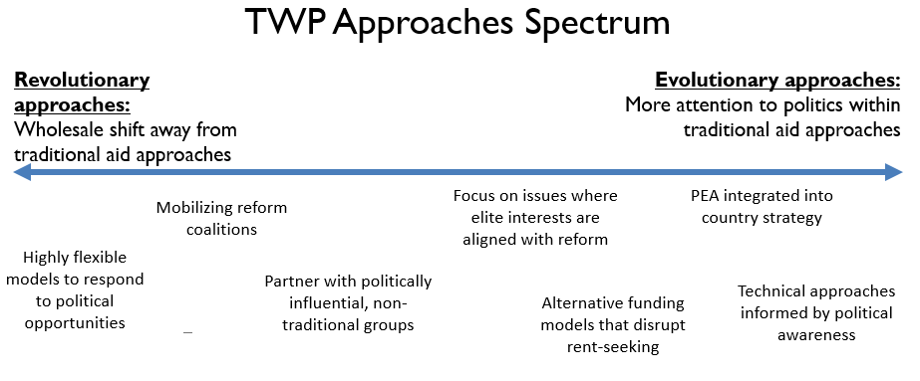
A spectrum

Slide 13
Big lessons
More thinking needed at selection
How much space for flexibility at design stage?
Design ‘in’ assumptions
ToA should not masquerade as a ToC
Structure teams appropriately with a mix of skills
Regular / frequent interrogation
Clear rules of the game (authorizing environment, delegation etc)

