Slide 1
Applying adaptive management to your work
Leni Wild, Research Associate, ODI

Slide 2
Why we need adaptive management: COVID-19
Unprecedented impacts of current pandemic
Shines spotlight on role of science and data in guiding decision making
Requires effective collective decision-making: interpret and use the best available emerging evidence and shifting scientific understanding, in ways that help to navigate considerable uncertainties
Many countries now in phase of needing to ‘adaptively trigger’ local responses

Slide 3





We know what doesn’t work
Assuming certainty
Technocratic solutions
Following one big plan
Elitist & top-down
Rigid adherence to fixed targets

Slide 4
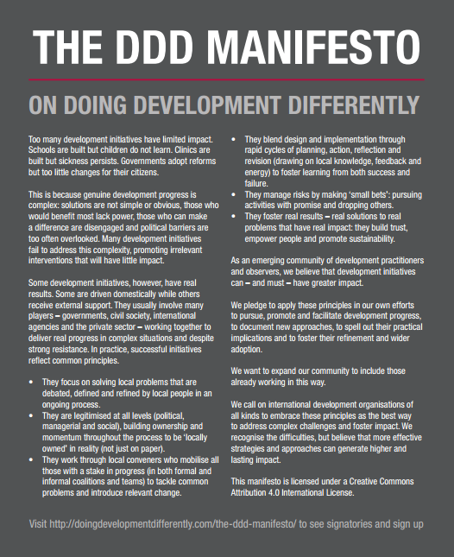
So what else can be done?
Three key ingredients:
Problem driven, politically smart
Agile, adaptive, entrepreneurial
Locally led
www.doingdevelopmentdifferently.com

Slide 5
An example: Doing things differently in the Philippines
The Asia Foundation (USAID funding)
Choice of objective: technically sound and political feasible
Entrepreneurial logic: Series of small bets, iterative learning, ‘searching’ for what is feasible
Self-motivated multi-skilled reform teams
Skilled coaching and support
Supportive funding arrangement
Counter-factual: Large scale technical assistance programme that didn’t deliver

Slide 6
How to move to sustained changes in practice?
Sustained change will require:
Changes to systems and processes
Understanding behaviours and incentives within aid and development
Mobilising leaders to push for change

Slide 7
Changes to systems and processes
Programmes or portfolios should have clear goals/objectives, set out and agreed in advance
The means of achieving these goals (activities and outputs) cannot be specified to the same level – instead, what should be specified is a clear, structured process for testing and learning
This requires assessing interventions based on how well they learn and adapt, not on whether they have rigidly stuck to an initial plan, as well as whether they have delivered results against the overall objective.
We call this ‘adaptive rigour’ – creating a documented, transparent trail of intentions, decisions and actions

Slide 8
Some implications
Changes are needed to:
Procurement and contracting models (e.g. relational contracting, co-production for procurement)
Reporting and accountability processes (e.g. learning indicators rather than pre-set deliverables)
Staff skill sets and professional rewards (e.g. internal champions, changing competencies for senior managers)

Slide 9
This requires supportive management & working cultures
Leadership vision and supportive management culture across teams
Creating cultures of ‘continuous improvement’
At a minimum, leaders need to allow space for these ways of working
Balance between oversight and space for decentralised decision making
Setting clear expectations for how decisions are taken
Higher standards of openness and transparency

Slide 10
How to take this further
Flexibility or “adaptiveness by default” is easier than “adaptiveness by design”
Staff still find it easier to be more reactive or responsive once a programme is up and running, than to recognise uncertainty at the start and plan for it
Results frameworks still make compromises with blueprint thinking
It is more common to have flexi-logframes (updated frequently) than frameworks that really reward learning
There is still a perceived hunger for “certainty”, rather than robust systems for dealing with uncertainty, which influences both approvals and the decisions made by implementing partners

Slide 11
How to take this further
Adaptiveness needs to be taken to more strategic levels
There is too much focus on the individual programme, rather than integrating this within portfolios, country strategies and so on
Local leadership of problem solving remains the biggest challenge
There are some good models of “arm’s length” funding but much more to do to show commitment to locally-led problem solving
Embedding this requires political leadership and further changes in management styles and organisational culture
Lessons can be drawn from private sector innovations for how to create the right conditions for adaptation – including maintaining ‘leadership vision’, incentivising learning and innovation, building trust

