Slide 1

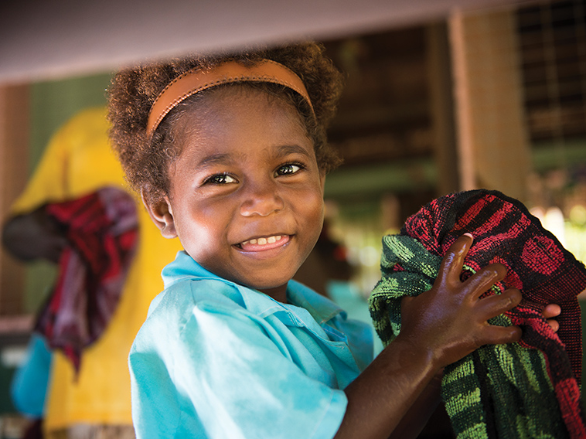


Paul Ronalds
Group Chief Executive
Notes:
Wonderful to be presenting at another CID event – an update to an address I provided at the CID Annual Conference in Nov 2017.
At that event, I argued that only “those INGOs prepared and able to undertake significant change will survive” and that “overall, NGOs have failed to be sufficiently innovative or been prepared to cannibalise their own business model to improve outcomes for beneficiaries fast enough”. And I recommended that NGOs needed to act quickly to get their house in order.
Today, I will suggest that the day of reckoning for many NGOs may have arrived – the immediate and ongoing impacts of cv-19 will be a true test of whether you have made the necessary changes to fit for the new strategic environment.
But first, let me quickly refresh your memories on the pre-cv-19 challenges…

Slide 2
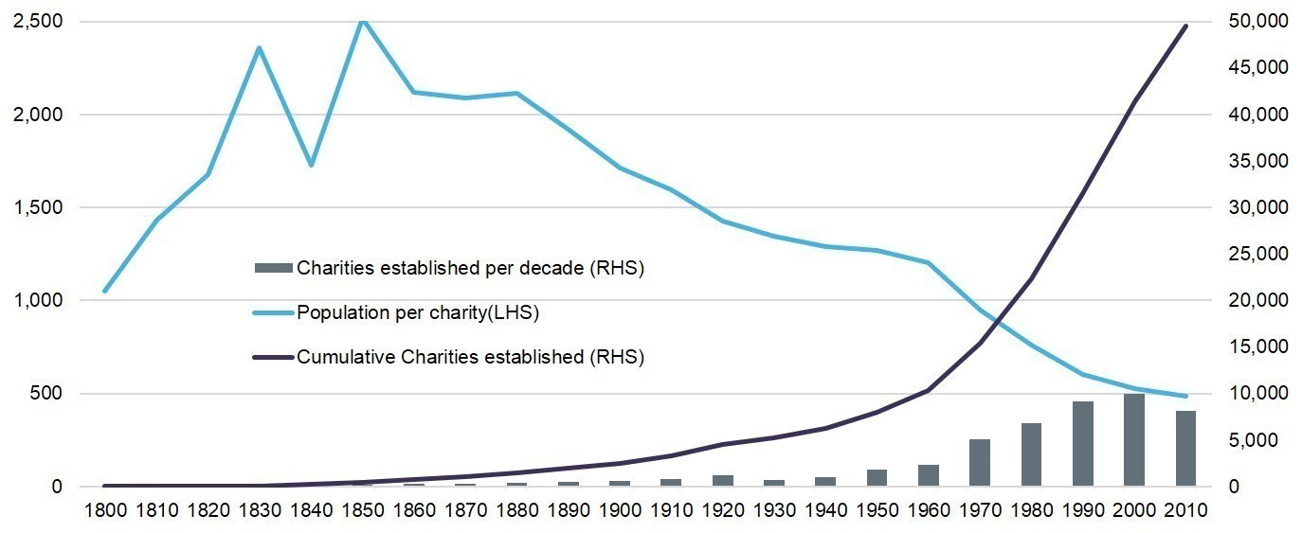
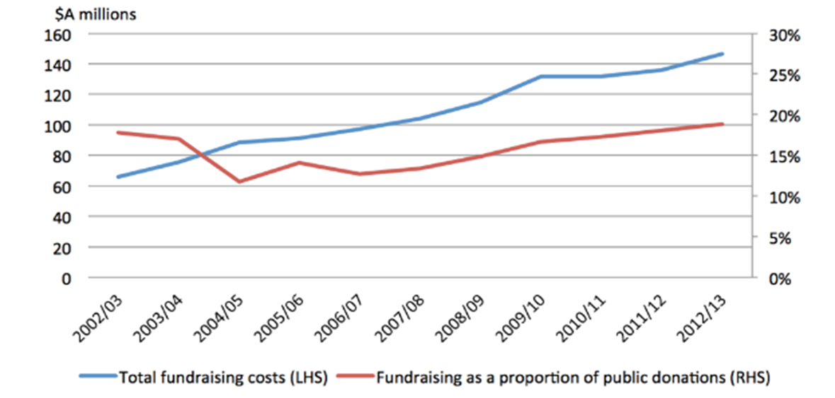
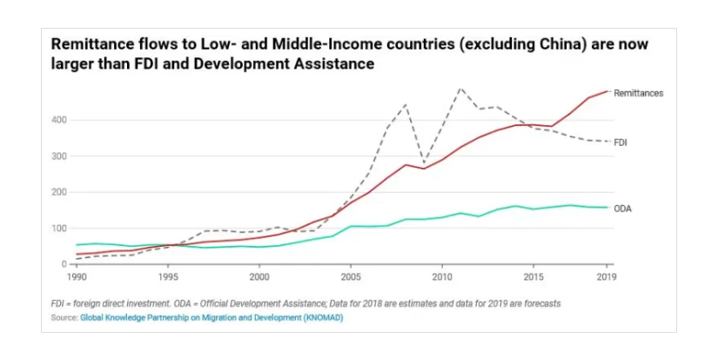
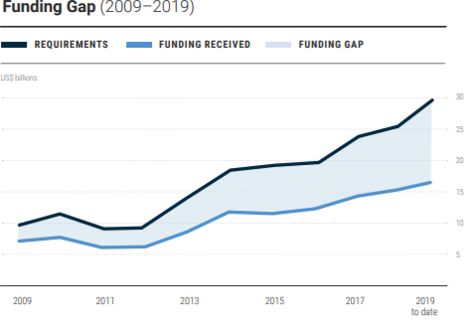
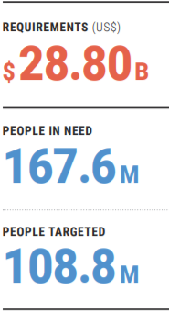
The story so far…
A broken ‘business’ model…
Too many NGOs chasing too few dollars
…leading to reduced financial sustainability
2020 projections
…all using the same business model
…unable to respond to the growing need
Notes:
Prior to Covid-19, our sector’s business model was already ‘broken’. Many NGOs were only surviving because of their historical investments in growing regular giving and financial reserves.
In most countries, there is simply too many NGOs, chasing too few dollars, all generally using the same business models in a sector experiencing declining fundraising ROI at a time of escalating costs and demand.

Slide 3
The story so far…
In the context of simultaneous disruption across multiple aspects of our organisations
Context
Who & Where
Operating Model
What
Financial Model
Notes:
Looked at from a business model perspective, the sector faced simultaneous disruption across all four business model elements, compounded by an increasingly challenging social and political environment.
Context: loss of trust in institutions, including charities; antagonistic political and media environment; growing staff safety issues
Who & Where
The changing face of global poverty, more focus on fragile states and discriminated groups;
Growing inequality in middle and high income contexts – as the SDGs make clear, we are all developing countries now;
Record numbers on the move;
What
Discrimination often rooted in politics, making policy work & advocacy more important but also more difficult;
New technologies (edutech, e-health, fintech etc) provide new opportunities to deliver at much lower cost but the sector lacked the expertise to exploit;
Impact of climate change, DRR;
Growth in cash programming
Operating Model
Direct funding of local NGOs;
Use of Managing Contractors; competition from consulting firms; lack of scale/access to capital to compete;
Private sector agenda
Impact of disintermediation on long supply chains;
Highly fragmented and competitive charity space
Financial Model
Stagnant ODA (although NZ has seen a boost in its foreign aid - New Zealand's ODA will increase from 0.25% of GNI in 2016 to 0.28% by 2021, up from 0.25 per cent in 2016).; Increased use of results-based contracts
Declining margins on bilateral and multilateral grants;
Stagnant donors in Aust (at 1983 levels); rising acquisition and attrition undermining ROI of mass fundraising;
Rising costs from increasing stakeholder expectations (impact, risk etc);
Growth in PAFs, intergenerational wealth transfer

Slide 4
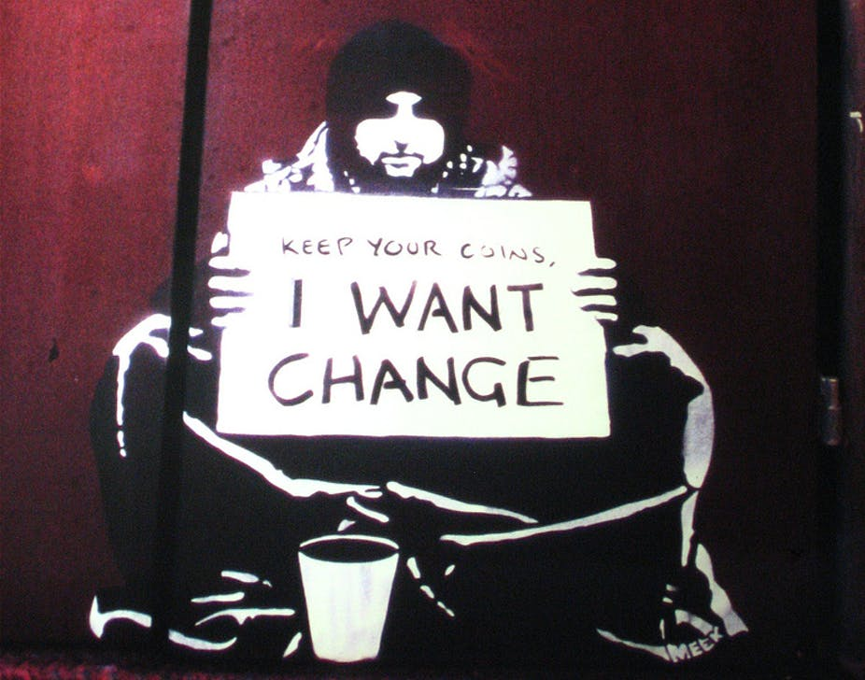
The story so far…
With limited operational & strategic agility
Notes:
Any sector facing this level of disruption will struggle but its particularly difficult for the iNGO sector.
Despite all of the challenges, there has been remarkable little change in the make-up of Australia’s largest charities over recent decades (see JB Were Cause Report, 2016, p.11).
For the most part, the sector looks very similar to the way that did 20 years ago, just much bigger. Unfortunately, many charities, despite their innovative beginnings, have become radical ideas stuck in concrete.
Why has the sector been so slow to respond to these change challenges?
Boards and executive teams have not focused enough on long-term strategic trends. Despite the rhetoric about mission, most boards and management teams prioritise the organisation over their mission.
Lack incentives to make changes before value is destroyed
Many organisations living hand to mouth – no financial surplus to respond, declining fundraising efficiency is making it even harder
Donors have starved charities of the capital they need. Donors want as much money to be spent on direct program costs and see investments in organisational capacity as mere administration, to be minimised. This thinking is often encouraged by charities themselves.
Charities have systemically underinvested in IT for decades. They general fail to invest in the professional development of their people.
The result is a sector woefully unprepared to respond to the challenges it now confronts.

Slide 5

Notes:
And then came covid-19…

Slide 6
Then Covid-19 struck
Covid-19 will exacerbate the underlying trends faced by the sector
A further decline in the ROI of fundraising:
  Donor attrition may increase as unemployment increases;
  Structured philanthropy, major donors and corporate philanthropy will fall due to stock market performance
Governments shift to tighten expenditure following huge cv-19 stimulus:
  Possible cuts to aid budgets (but ongoing strategic competition with China in our region)
  Increased pressure on NGO Value For Money & accountability
Disruptive opportunity of tech (edutech, e-health, fintech) and data
Sector disruption as financial and operational pressures bite (significant % of charities non-viable):
  Consolidation opportunities
  Pressure from for-profit competitors
Ongoing travel restrictions; increased demand for remote, flexible working and localisation of workforce
Decline of traditional media (including AAP) make ‘cut through’ even harder
Notes:
The greatest impact of covid-19 will be to accelerate key underlying trends.
CV-19 is likely to accelerate the decline of traditional media across the world. Although readership is up (and some online subscriptions), there has been a massive decline in advertising revenue. Some are suggesting (The Economist) that 40-50% of what is lost may never come back.

Slide 7
Then Covid-19 struck
And add some new challenges
Changes in thematic focus by institutional donors?
  Away from infrastructure to community health?
  Even more appetite for cash transfers
Falling away of non-traditional donors (OPEC Countries, Russia, Brazil) as oil prices plummet and they confront domestic challenges
Increased instability from economic and social impact of cv-19
  Increased risk of violence in the Pacific
  Increased global malnutrition
Changing “Overton Window”:
  Maybe, increased appreciation for internationally interconnected risk e.g. global health security, climate change
  Stronger policy link between foreign aid & national interest?
  Or a new excuse for nationalism, isolationism, anti-immigration policies?
Notes:
In countries with weak governments, pre-existing economic problems and the economic impacts of cv-19 could combine to create significant additional instability. e.g. Lebanon’s protests this week. For oil producing countries, they have the added challenge of sharp falls in oil revenue.
Falling remittances and food shortages will also add to the challenges.
In our region, PNG's brew of debt-laden government, poor health services and social fragmentation means it is uniquely placed to suffer at the hands of coronavirus. So far, eight coronavirus cases have been detected in PNG, but there's little to commend in the low numbers. They've been detected in four different provinces, with no clear source for most.
WFP are suggesting that: “More than 30 countries in the developing world could experience widespread famine, and in 10 of those countries there are already more than 1 million people on the brink of starvation” (David Beasley, Executive Director of the World Food Programme).
Remittances – in 2018, officially recorded remittances were US$46b, far more than foreign direct investment at US$32b (undeclared remittances could be $16b-$35b more). As migrants lose work in high-income countries remittances will fall, however, its also getting hard to transfer the funds. How far remittances fall depends chiefly on the severity of the downturn. Before the global financial crisis they were rising by about 10% a year, but in 2009 they slumped by 5%. The plunge this year will probably be far worse. Remittance flows normally go up when African economies are slumping, because migrants hear more urgent pleas for help from relatives back home. Now they are dropping at the same time as African economies are stumbling (The Economist, Covid Dries Up a Cash Cow). On the other hand, the time bound suspension of debt repayments for the poorest countries announced by the G20 on 15 April 2020 will provide some relief.
The chair of GAVI has argued “The realization that the economic costs of a pandemic can be huge, far surpassing investments in research and prevention, will lead to billions more dollars of investment in research, vaccines, therapeutics, and non-medical methods of prevention”. INGOs could benefit.

Slide 8

How do you respond?
Notes:
For many NGOs, these challenges will require a fundamental change to strategy and deep structural change.
The key question is whether management teams and their boards can overcome the barriers to change before too much value is destroyed.
The changes that are required will clearly depend on the specific organisation but the following should be on your list to consider:
Do you have the right leadership and talent? “The quality of INGO leaders and the professionalism of staff is undoubtedly the single most critical element in these organizations effectively responding to the increasingly complex and unpredictable challenges they face”
What improvements to BAU can be made to give you more time to make strategic changes? A crisis often creates a much more conducive environment for change.
Optimising Existing Fundraising methods while investing in new channels/platforms. Eg CRM investment
Changing the way we engage with supporters. An important area for immediate focus is improved story telling, especially on digital platforms.
Sharper focus on ‘value-for-money’.
Are you considering fundamental business model changes? And greater collaboration, including through mergers?
How are you harnessing the opportunities of new technologies?

Slide 9




Important to be ambidexterous
Simultaneously improving BAU while making strategic investment to meet new challenges
Impact
Fund
New Operating Models
How we drive efficiency, advantage and value creation
Consortium
Bids
Improve mass fundraising
Mergers & Acquisitions
Improve program quality
Outcomes based Contracts
Current Operating Model
Green Climate Fund
Retail
Purchase
Fit For Future
Existing Value Proposition
(e.g. ODA, mass, corporate & philanthropy, retail)
New Value Proposition
(e.g. new funds, fee-for-service, social impact investment funds)
Segments, services and revenue
Notes:
Lead and Disrupt, by Charles O’Reilly and Michael Tushman. The book provides really practical advice on how larger organisations have successfully been ‘ambidexterous’: able to continuously improve the existing parts of their operations while also being successful in new areas
Save the Children Australia has pursued this ‘ambidexterous approach’…
Strengthened program evidence + a new social enterprise: the Centre For Evidence & Implementation
Finalised four mergers: actively seeking more.
Increased consortium bids; actively pursuing results-based contracts (including social impact bonds)
Pursued an innovation agenda, new endowment fund, our own Impact Investment Fund, formal relationships with incubators/accelerators
Mix of for-profit and not-for-profit joint ventures: HLP and Inclusiv Ventures
All supported by ongoing investments in a robust operating platform

Slide 10





No simple solutions to so many strategic challenges
Responding to such disruption requires careful sequencing (now, next, later)
Good Beginnings merger
Save the Children invested $1M in post-merger integration
Expanded footprint and social impact in Australia
Generating $1M value p.a.
Merger to help the enterprise extend reach
Maintained standalone brand
Grown from 71 to 115+ school sites since merger
Merged in 2018, invested $400k
65% revenue growth in calendar year 2019
Further growth opportunities
Merged in 2020
Growth opportunity in Aus & overseas
2014 | 2015 | 2016 | 2017 | 2018 | 2019 | 2020
Seeded in 2015 with $450k
$1.7m working capital facility for growth
Grown to $5M+ income p.a.
Offices in Australia, Singapore, UK
Joint venture with two co-founders; extended $440k shareholders loan
Social business to assist the private sector
Leading an education partnership in PNG
Retail shop acquisition - Smith Family (large domestic NGO) sought to simplify operations
SCAus purchased 17 retail shops in NSW
Notes:
But we haven’t done it all at once – change needs to be carefully prioritised and sequenced.

